Slide 1

Claude Wisdom AI
June 2024

Slide 2
Agenda
Proposed architecture for integration
Description product
Cost estimate

Slide 3
Proposed Architecture for Integration

Slide 4
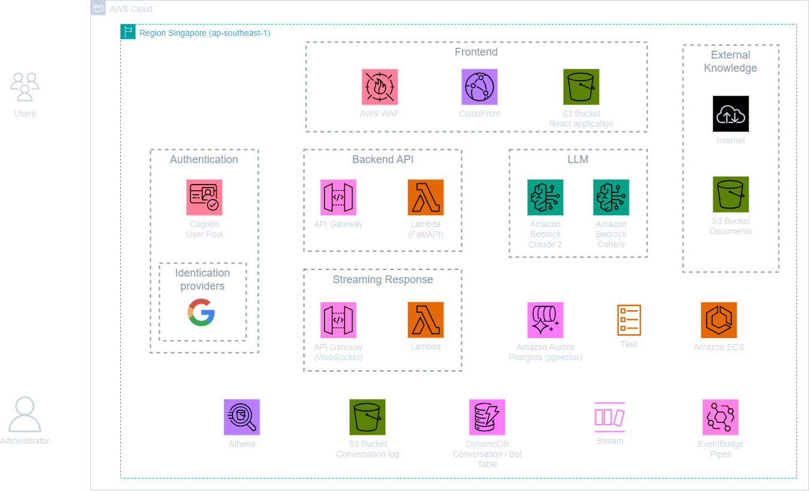
High Level Architecture

Slide 5
Description Product

Slide 6
Description Product
Chatbot using the Anthropic company's LLM Claude, one of the foundational models provided by Amazon Bedrock for generative AI.

Slide 7
AWS Infrastructure Cost Estimation

Slide 8
Assumptions
Number of API call: 1.500.000 requests/month
Storage for storing documents: 200 GB
Storage for storing web applications: 2 GB
Storage for storing conversation logs: 40 GB
Database for storing conversations: 30 GB
Database for storing vector: 20 GB
Using LLM: Claude 3 Sonnet

Slide 9
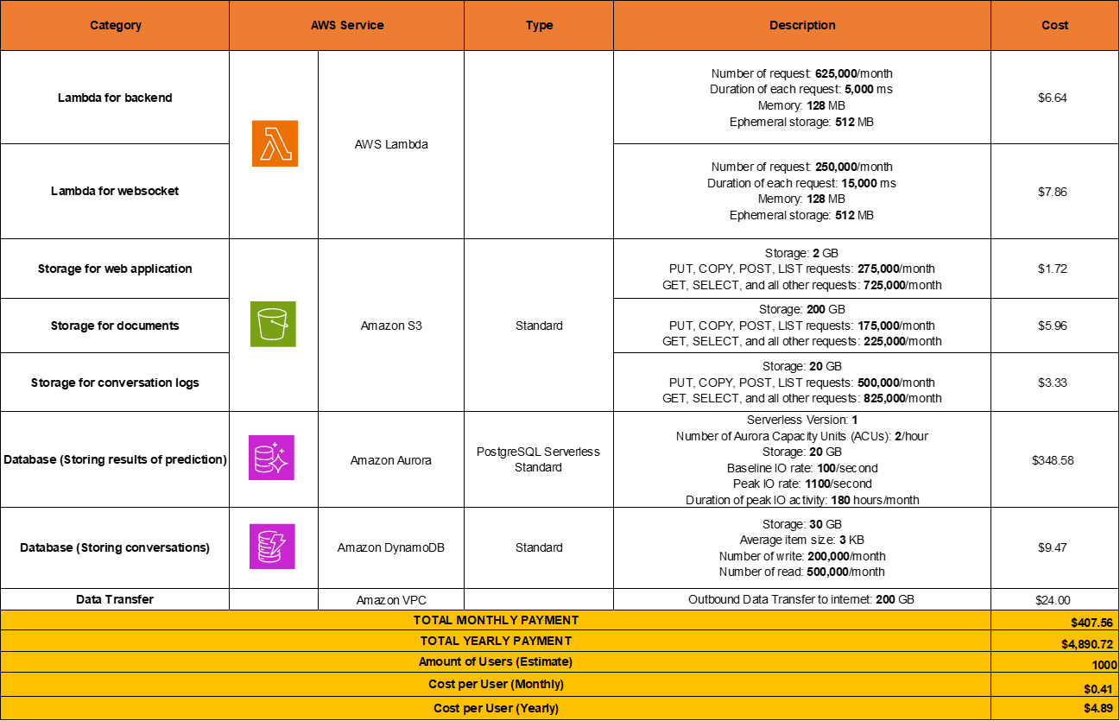
Cost for Infrastructure

Slide 10
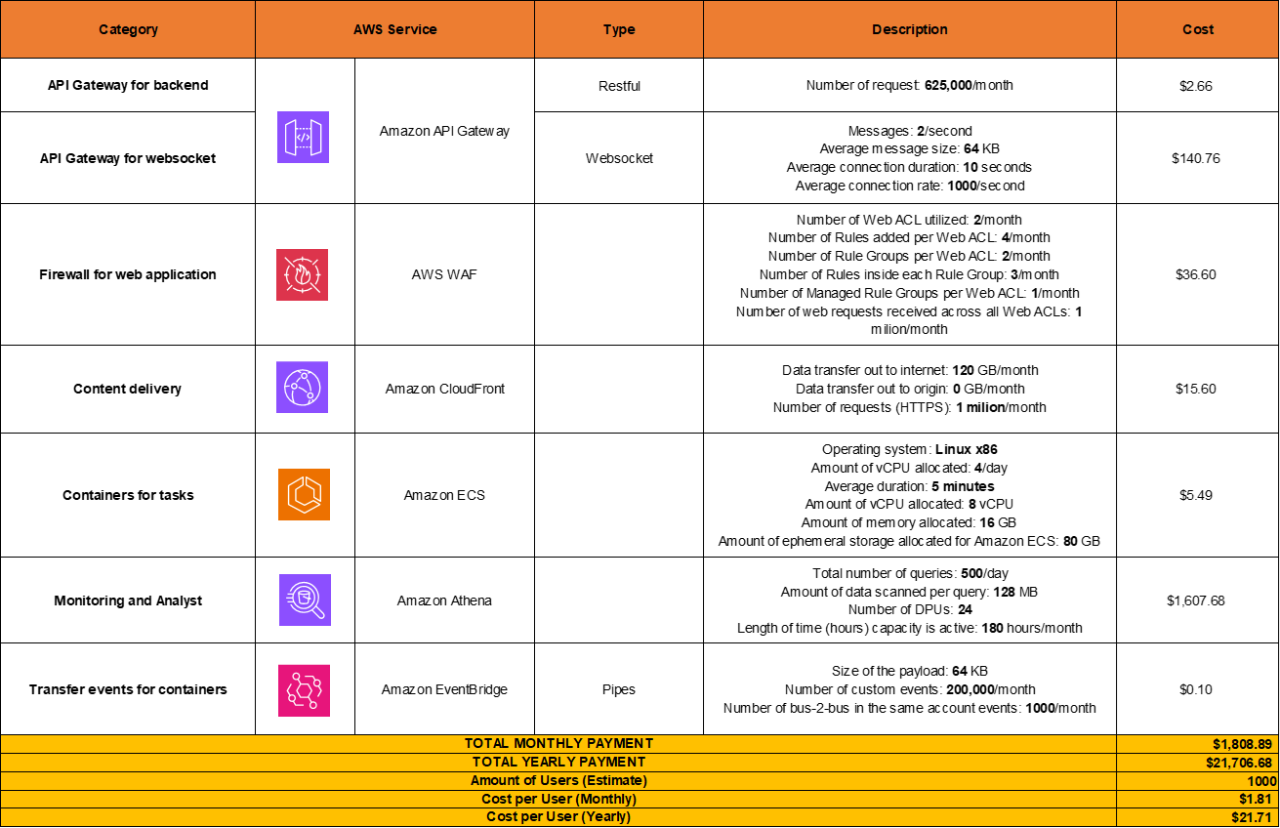
Cost for Infrastructure

Slide 11
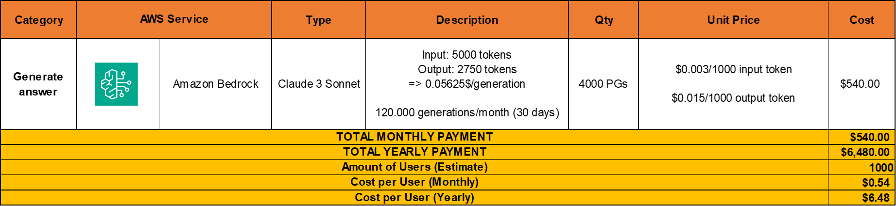
Cost for AI Model LLM

Slide 12
Summary Cost
Reference
Services in Singapore (exclude Bedrock): view here
Bedrock pricing (Sydney): Build Generative AI Applications with Foundation Models - Amazon Bedrock Pricing - AWS

